Slide 2
CNTK:
The Microsoft Cognition Toolkit
Democratizing the AI tool chain: Open-Source Deep-Learning like Microsoft Product Groups Frank Seide Principal Researcher Speech Recognition, CNTK Architect Microsoft Research
With many contributors:
A. Agarwal, E. Akchurin, C. Basoglu, G. Chen, S. Cyphers, W. Darling, J. Droppo, A. Eversole, B. Guenter, M. Hillebrand, X. Huang, Z. Huang, R. Hoens, V. Ivanov, A. Kamenev, N. Karampatziakis, P. Kranen, O. Kuchaiev, W. Manousek, C. Marschner, A. May, B. Mitra, O. Nano, G. Navarro, A. Orlov, M. Radmilac, A. Reznichenko, P. Parthasarathi, B. Peng, A. Reznichenko, W. Richert, M. Seltzer, M. Slaney, A. Stolcke, T. Will, H. Wang, W. Xiong, K. Yao, D. Yu, Y. Zhang, G. Zweig

Slide 3
The Microsoft Cognition Toolkit (CNTK)
Microsoft’s open-source deep-learning toolkit
ease of use: what, not how
fast
flexible
1st-class Windows support
internal=external version

Slide 4







deep learning at Microsoft
Microsoft Cognitive Services
Skype Translator
Cortana
Bing
HoloLens
Microsoft Research

Slide 5
ImageNet: Microsoft 2015 ResNet
Microsoft had all 5 entries being the 1-st places this year: ImageNet classification, ImageNet localization, ImageNet detection, COCO detection, and COCO segmentation

Slide 6
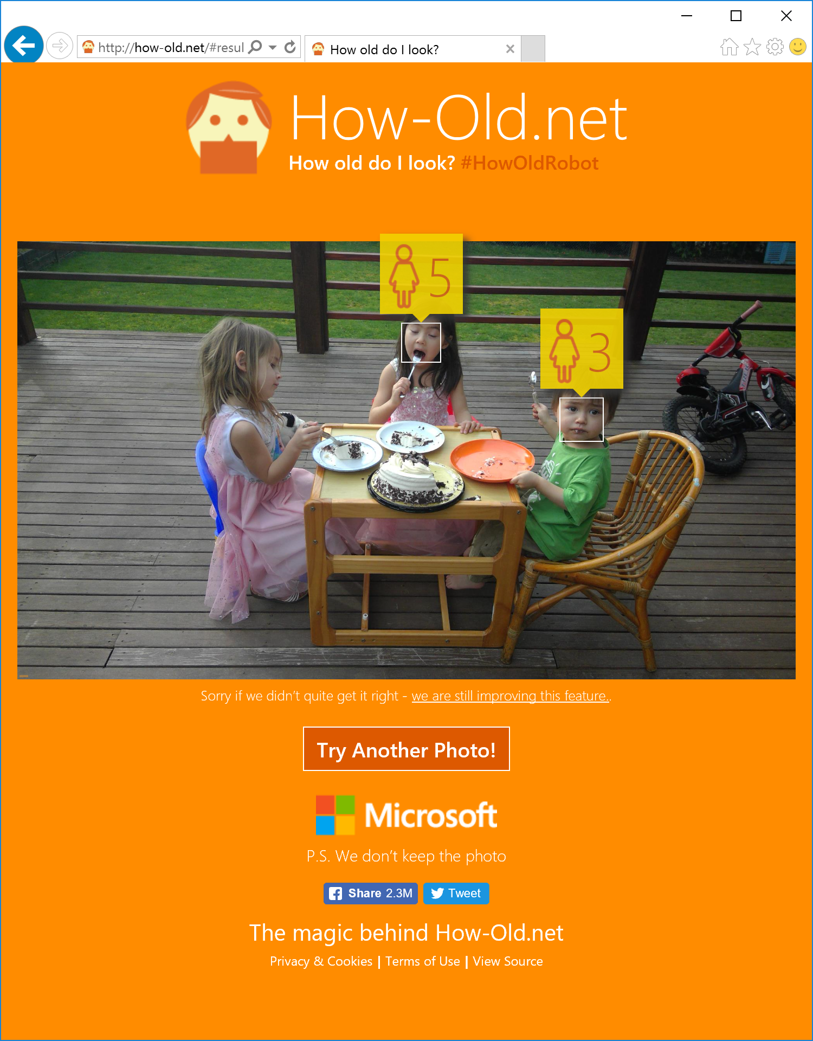


Slide 7
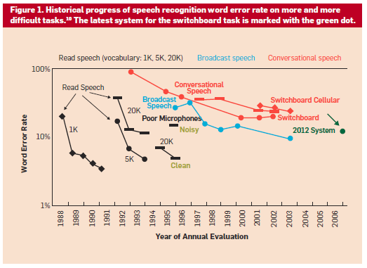
24%
14%

Slide 8
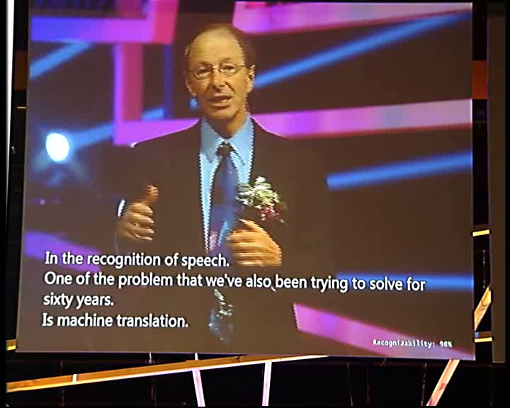
Click here to watch on Youtube
Notes:
https://www.youtube.com/watch?v=Nu-nlQqFCKg;start=285
seek to video position 4:45 to see neural networks transcribing the speech live on-stage

Slide 9
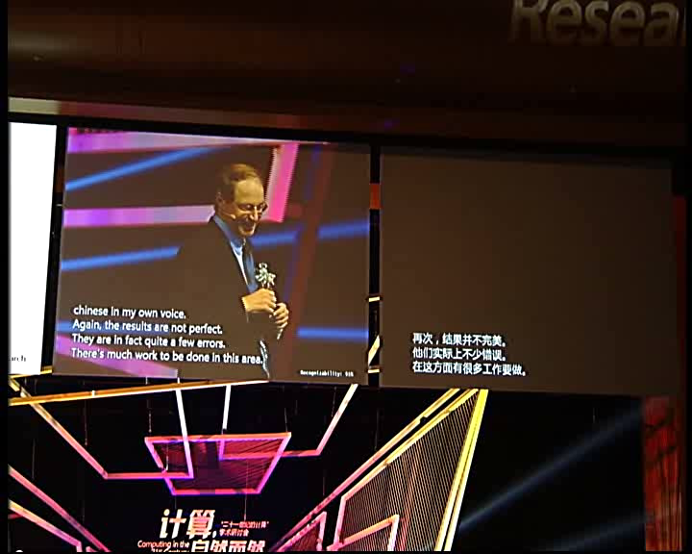
Click here to watch on Youtube
Notes:
https://www.youtube.com/watch?v=Nu-nlQqFCKg;start=475
show video around 7:55 to see automatic translation powered by the NN-based speech recognizer

Slide 10

Microsoft’s new speech breakthrough
Microsoft 2016 research system for conversational speech recognition
6.2% word-error rate
all experiments were run on CNTK
[W. Xiong, J. Droppo, X. Huang, F. Seide, M. Seltzer, A. Stolcke, D. Yu, G. Zweig: “The Microsoft 2016 Conversational Speech Recognition System,” http://arxiv.org/abs/1609.03528]

Slide 11
I. what is CNTK II. how to use CNTK III. deep dive into CNTK technologies IV. examples source-code walkthroughs

Slide 12
CNTK “Cognition Toolkit”
CNTK is Microsoft’s open-source, cross-platform toolkit for learning and evaluating deep neural networks.
CNTK expresses (nearly) arbitrary neural networks by composing simple building blocks into complex computational networks, supporting relevant network types and applications.
CNTK is production-ready: State-of-the-art accuracy, efficient, and scales to multi-GPU/multi-server.

Slide 13
“CNTK is Microsoft’s open-source, cross-platform toolkit for learning and evaluating deep neural networks.”
open-source model inside and outside the company
created by Microsoft Speech researchers (Dong Yu et al.) in 2012; open-sourced (CodePlex) in early 2015
on GitHub since Jan 2016 under permissive license
“working out loud:” virtually all code development is out in the open
used by Microsoft product groups
CNTK-trained models power more and more Microsoft products
several teams have full-time employees on CNTK that actively contribute
external contributions e.g. from MIT and Stanford
Linux, Windows, docker, cudnn5
Python and C++ API beta in October; followed by C#/.Net

Slide 14
“CNTK expresses (nearly) arbitrary neural networks by composing simple building blocks into complex computational networks, supporting relevant network types and applications.”
example: 2-hidden layer feed-forward NN
h₁ = σ(W₁ x + b₁) h1 = Sigmoid (W1 * x + b1)
h₂ = σ(W₂ h₁ + b₂) h2 = Sigmoid (W2 * h1 + b2)
P = softmax(W_{out} h₂ + b_{out}) P = Softmax (Wout * h2 + bout)
with input x ∈ R^{M} and one-hot label y ∈ R^{J}
and cross-entropy training criterion
ce = y^{T} log P ce = CrossEntropy (y, P)
Σ_{corpus}ce = max

Slide 15
“CNTK expresses (nearly) arbitrary neural networks by composing simple building blocks into complex computational networks, supporting relevant network types and applications.”
ce
CrossEntropy
P
Softmax
b_{out}
+
h1 = Sigmoid (W1 * x + b1)
h2 = Sigmoid (W2 * h1 + b2)
P = Softmax (Wout * h2 + bout)
ce = CrossEntropy (y, P)
W_{out}
•
h₂
σ
b₂
+
W₂
•
h₁
σ
b₁
+
W₁
•
x
y

Slide 16
“CNTK expresses (nearly) arbitrary neural networks by composing simple building blocks into complex computational networks, supporting relevant network types and applications.”
ce
nodes: functions (primitives)
can be composed into reusable composites
edges: values
arbitrary-rank tensors with static and dynamic axes
automatic dimension inference
sparse-matrix support for inputs and labels
automatic differentiation
∂F / ∂in = ∂F / ∂out ∙ ∂out / ∂in
deferred computation → execution engine
optimized execution
memory sharing
editable, clonable
CrossEntropy
P
Softmax
b_{out}
+
W_{out}
•
h₂
σ
b₂
+
W₂
•
h₁
σ
b₁
+
W₁
•
x
y

Slide 17
“CNTK expresses (nearly) arbitrary neural networks by composing simple building blocks into complex computational networks, supporting relevant network types and applications.”
Lego-like composability allows CNTK to support a wide range of networks, e.g.
feed-forward DNN
RNN, LSTM, GRU
convolution
DSSM
sequence-to-sequence
for a range of applications including
speech
vision
text
and combinations

Slide 18
“CNTK is production-ready: State-of-the-art accuracy, efficient, and scales to multi-GPU/multi-server.”
state-of-the-art accuracy on benchmarks and production models
multi-GPU/multi-server parallel training on production-size corpora

Slide 19
“CNTK is production-ready: State-of-the-art accuracy, efficient, and scales to multi-GPU/multi-server.”
Benchmarking on a single server by HKBU
seconds per minibatch on G1080 (G980) GPU; lower=better
 | FCN-8 | AlexNet |  | ResNet-50 |  | LSTM-64
CNTK | 0.037 | 0.040 | (0.054) | 0.207 | (0.245) | 0.122
Caffe | 0.038 | 0.026 | (0.033) | 0.307 | (-) | -
TensorFlow | 0.063 | - | (0.058) | - | (0.346) | 0.144
Torch | 0.048 | 0.033 | (0.038) | 0.188 | (0.215) | 0.194
[“Benchmarking State-of-the-Art Deep Learning Software Tools,” http://arxiv.org/pdf/1608.07249v5.pdf]

Slide 20
“CNTK is production-ready: State-of-the-art accuracy, efficient, and scales to multi-GPU/multi-server.”
Notes:
(note: may no longer be up-to-date)

Slide 21
I. what II. how to III. deep dive IV. examples

Slide 22
how to: CNTK architecture
CNTK
reader
• task-specific deserializer
• automatic randomization
network
• network definition
• CPU/GPU execution engine
learner
• SGD (momentum, AdaGrad, …)
• minibatching, packing, padding
corpus
model

Slide 23
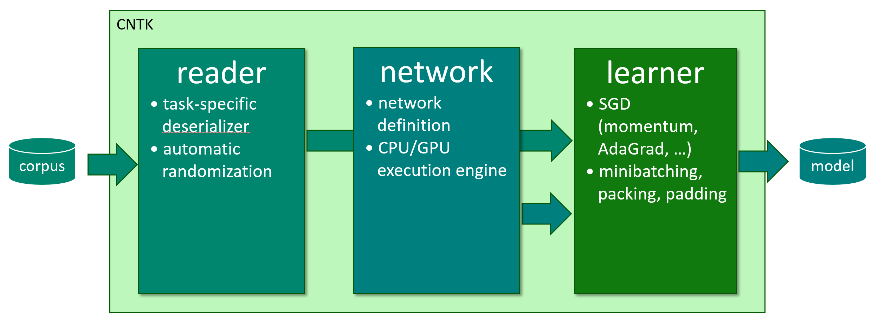
how to: top-level configuration
cntk configFile=yourConfig.cntk command=“myTrain:myEval" root="exp-1"
# content of yourConfig.cntk:
myTrain = {
action = "train"
deviceId = "auto"
modelPath = “$root$/models/model.dnn"
reader = { … }
BrainScriptNetworkBuilder = { … }
SGD = { … }
}
myEval = { … }

Slide 24
how to: reader
reader = {
verbosity = 0 ; randomize = true
deserializers = ({
type = "ImageDeserializer" ; module = "ImageReader"
file = "$dataDir$/cifar-10-batches-py/train_map.txt"
input = {
features = { transforms = (
{ type = "Crop" ; cropType = "random" ; cropRatio = 0.8 } :
{ type = "Scale" ; width = 32 ; height = 32 ; channels = 3 } :
{ type = "Transpose" }
)}
labels = { labelDim = 10 }
}
})
}
automatic on-the-fly randomization important for large data sets
readers compose, e.g. image → text caption
Notes:
(just explain: (1) deserialization incl. IDeserializer and (2) auto-randomization)

Slide 25
how to: reader
Getting your data into CNTK:
standard formats: images, speech (HTK, Kaldi)
convert to CNTK Text Format
sed -e 's/^/<s> /' -e 's/$/ <\/s>/' < en.txt > en.txt1 sed -e 's/^/<s> /' -e 's/$/ <\/s>/' < fr.txt > fr.txt1 paste en.txt1 fr.txt1 | Scripts/txt2ctf.py --map en.dict fr.dict > ef.ctf
big data: implement custom deserializer in C++ or Python¹
small data: read with your favorite Python lib to RAM¹
¹Python support beta scheduled for October 2016
Notes:
(just explain: (1) deserialization incl. IDeserializer and (2) auto-randomization)

Slide 26
how to: network
network specification consists of:
the network function’s formula
including learnable parameters
(but no gradients, which are automatically determined by the system)
inputs
the output(s) and training/evaluation criteria
network descriptions are called “brain scripts”
custom network description language “BrainScript”
can soon be done using Python, C++, and C#/.Net

Slide 27
how to: network
ce
CrossEntropy
M = 40 ; N = 512 ; J = 9000 // feat/hid/out dim
x = Input{M} ; y = Input{J} // feat/labels
W1 = Parameter{N, M}; b1 = Parameter{N, 1}
W2 = Parameter{N, N}; b2 = Parameter{N, 1}
Wout = Parameter{J, N}; bout = Parameter{J, 1}
h1 = Sigmoid(W1 * x + b1)
h2 = Sigmoid(W2 * h1 + b2)
P = Softmax(Wout * h2 + bout)
ce = CrossEntropy(y, P)
P
Softmax
b_{out}
+
W_{out}
•
h₂
σ
b₂
+
W₂
•
h₁
σ
b₁
+
W₁
•
x
y

Slide 28
how to: network
ce
CrossEntropy
M = 40 ; N = 512 ; J = 9000 // feat/hid/out dim
x = Input{M} ; y = Input{J} // feat/labels
Layer (x, out, in, act) = { // reusable block
W = Parameter{out,in}; b = Parameter{out,1}
h = act(W * x + b)
}.h
h1 = Layer(x, N, M, Sigmoid)
h2 = Layer(h1, N, N, Sigmoid)
P = Layer(h2, J, N, Softmax)
ce = CrossEntropy(y, P)
P
Softmax
b_{out}
+
W_{out}
•
h₂
σ
b₂
+
W₂
•
h₁
σ
b₁
+
W₁
•
x
y

Slide 29
how to: network
ce
CrossEntropy
M = 40 ; N = 512 ; J = 9000 // feat/hid/out dim
x = Input{M} ; y = Input{J} // feat/labels
Layer (x, out, in, act) = { … }
DNNStack (x, out, in, L) =
if L == 1 then Layer (x, out, in, Sigmoid)
else Layer (DNNStack (x, out, in, L-1),
out, out, Sigmoid)
hL = DNNStack(x, M, N, L) // parameterized
P = Layer(h2, J, N, Softmax)
ce = CrossEntropy(y, P)
P
Softmax
b_{out}
+
W_{out}
•
h₂
σ
b₂
+
W₂
•
h₁
σ
b₁
+
W₁
•
x
y
Notes:
functions can be recursive

Slide 30
how to: network
ce
CrossEntropy
M = 40 ; N = 512 ; J = 9000 // feat/hid/out dim
x = Input{M} ; y = Input{J} // feat/labels
DenseLayer {outDim, activation=Identity} = {
W = Parameter {outDim, Inferred}
b = Parameter {outDim, 1}
apply(x) = activation(W * x + b)
}.apply
h1 = DenseLayer{N, activation=Sigmoid}(x)
h2 = DenseLayer{N, activation=Sigmoid}(h1)
P = DenseLayer{J, activation=Softmax}(h2)
ce = CrossEntropy(y, P)
P
Softmax
b_{out}
+
W_{out}
•
h₂
σ
b₂
+
W₂
•
h₁
σ
b₁
+
W₁
•
x
y

Slide 31
how to: network
ce
CrossEntropy
M = 40 ; N = 512 ; J = 9000 // feat/hid/out dim
x = Input{M} ; y = Input{J} // feat/labels
DenseLayer {outDim, activation=Identity} = …
model = Sequential (
DenseLayer{N, activation=Sigmoid} :
DenseLayer{N, activation=Sigmoid} :
DenseLayer{J, activation=Softmax}
)
P = model (x)
ce = CrossEntropy(y, P)
P
Softmax
b_{out}
+
W_{out}
•
h₂
σ
b₂
+
W₂
•
h₁
σ
b₁
+
W₁
•
x
y

Slide 32
how to: network
ce
CrossEntropy
M = 40 ; N = 512 ; J = 9000 // feat/hid/out dim
x = Input{M} ; y = Input{J} // feat/labels
DenseLayer {outDim, activation=Identity} = …
model = Sequential (
DenseLayer{N} : Sigmoid :
DenseLayer{N} : Sigmoid :
DenseLayer{J} : Softmax
)
P = model (x)
ce = CrossEntropy(y, P)
P
Softmax
b_{out}
+
W_{out}
•
h₂
σ
b₂
+
W₂
•
h₁
σ
b₁
+
W₁
•
x
y

Slide 33
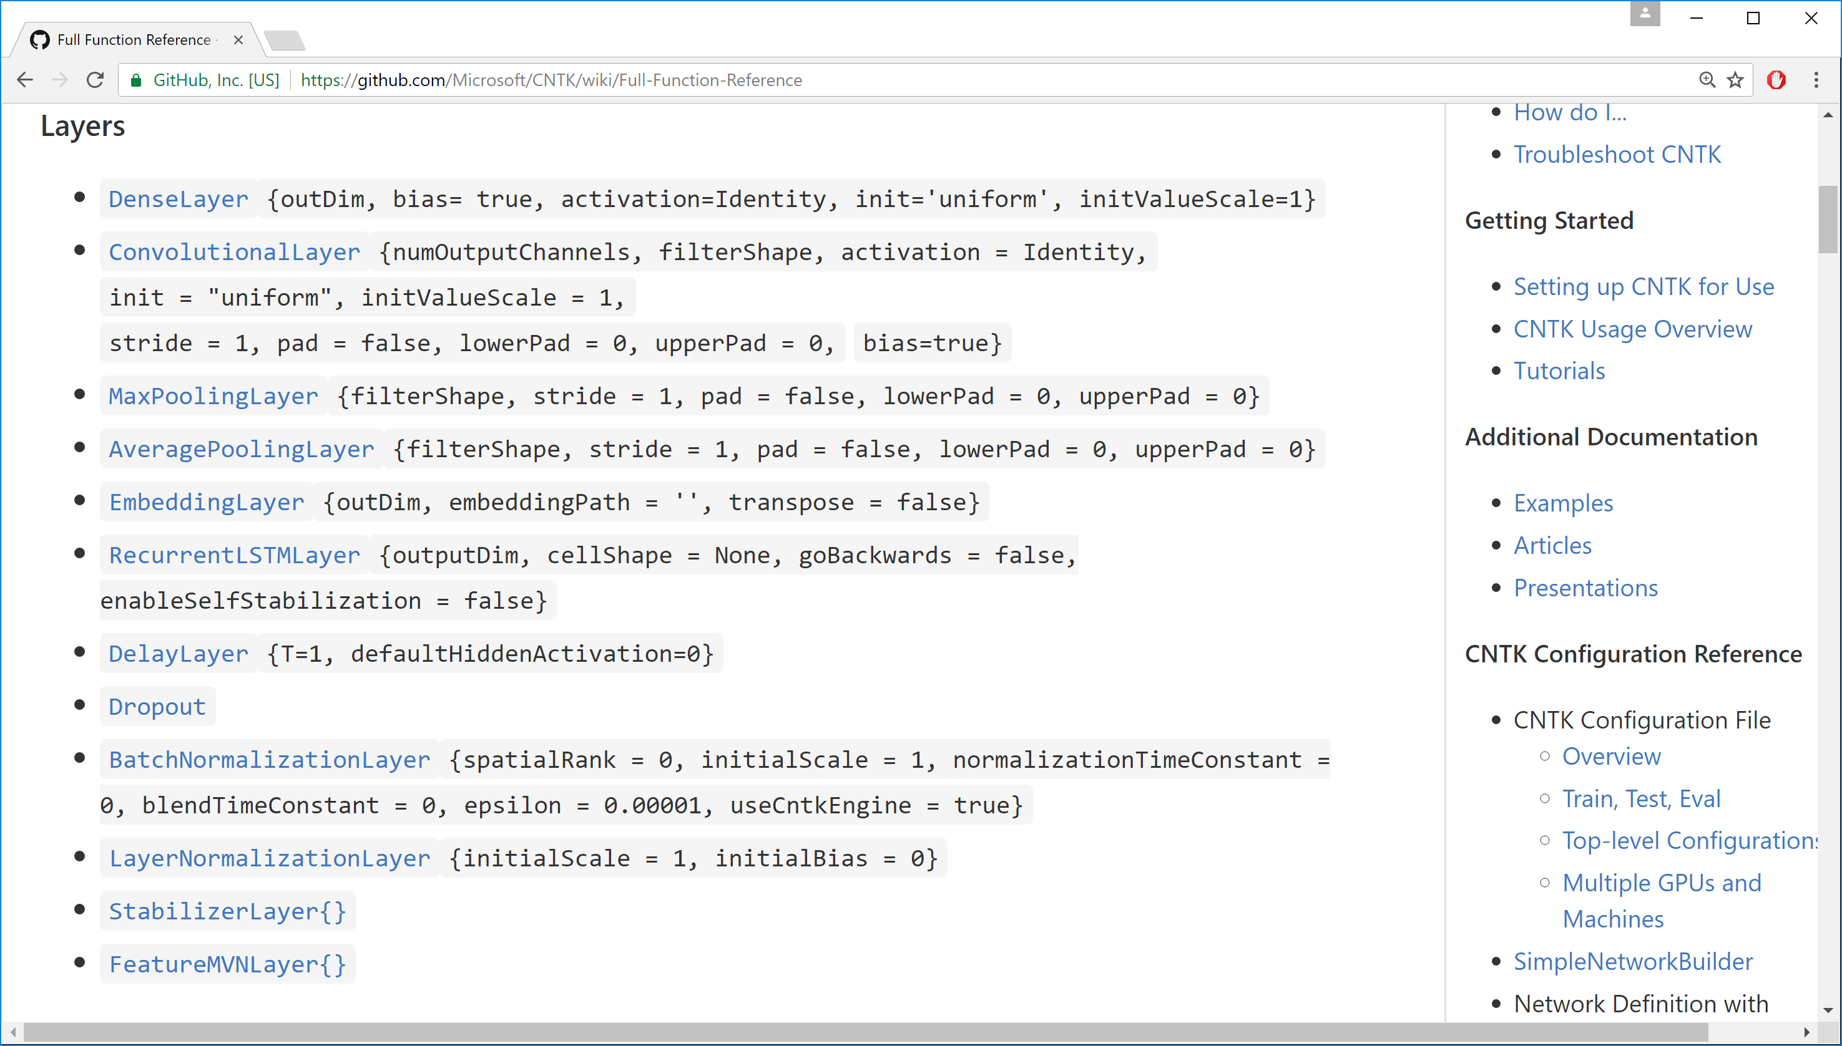
how to: network
... copy-paste Full Function Reference here
Notes:
note: this really just explained “programming”, but it’s important that it can be done

Slide 34
how to: network
CNTK BrainScript:
direct, down-to-earth, easily understandable syntax
high-level composability; custom functions/function objects (e.g. LSTM and GRU are expressed in BrainScript, not C++)
powerful yet easy-to-use library for standard layer types (written in BrainScript)
soon, BrainScripts can be written in Python, C++, and .Net

Slide 35
how to: “BrainScript??”
full name perfectly expresses our grand long-term ambition
two-letter acronym perfectly expresses today’s state of the degree that artificial neural networks actually implement brains
☺

Slide 36
how to: learner
SGD = {
maxEpochs = 50
minibatchSize = $mbSizes$
learningRatesPerSample = 0.007*2:0.0035
momentumAsTimeConstant = 1100
AutoAdjust = { … }
ParallelTrain = { … }
}
all learning parameters at a glance
various SGD variants (momentum, Adam, …)
MB-size agnostic learning rate and momentum
auto-adjustment of learning rate and minibatch size
multi-GPU/multi-server parallelization

Slide 37
how: typical workflow
configure reader, network, learner
train & evaluate:
mpiexec --np 16 --hosts server1,server2,server3,server4 \ CNTK configFile=myTask.cntk command=MyTrain:MyTest parallelTrain=true deviceId=auto
modify models, e.g. for layer building:
CNTK configFile=myTask.cntk command=MyTrain1:AddLayer:MyTrain2
apply model file-to-file:
CNTK configFile=myTask.cntk command=MyRun
use model from code
EvalDll.dll/.so (C++) or EvalWrapper.dll (.Net); V2 API beta in October

Slide 38
I. what II. how to III. deep dive IV. examples

Slide 39
deep dive
base features:
SGD with momentum, AdaGrad, Nesterov, etc.
computation network with automatic gradient
higher-level features:
auto-tuning of learning rate and minibatch size
memory sharing
implicit handling of time
minibatching of variable-length sequences
data-parallel training
you can do all this with other toolkits, but must write it yourself

Slide 40
deep dive: handling of time
extend our example to an RNN
h₁(t) = σ(W₁ x(t) + H₁ h₁(t-1) + b₁) h1 = Sigmoid(W1 * x + H1 * PastValue(h1) + b1)
h₂(t) = σ(W₂ h₁(t) + H₂ h₂(t-1) + b₂) h2 = Sigmoid(W2 * h1 + H2 * PastValue(h2) + b2)
P(t) = softmax(W_{out} h₂(t) + b_{out}) P = Softmax(Wout * h2 + bout)
ce(t) = L^{T}(t) log P(t) ce = CrossEntropy(L, P)
Σ_{corpus}ce(t) = max
→ no explicit notion of time
Notes:
add notion of time

Slide 41
deep dive: handling of time
extend our example to an RNN
h₁(t) = σ(W₁ x(t) + H₁ h₁(t-1) + b₁) h1 = Sigmoid(W1 * x + H1 * PastValue(h1) + b1)
h₂(t) = σ(W₂ h₁(t) + H₂ h₂(t-1) + b₂) h2 = Sigmoid(W2 * h1 + H2 * PastValue(h2) + b2)
P(t) = softmax(W_{out} h₂(t) + b_{out}) P = Softmax(Wout * h2 + bout)
ce(t) = L^{T}(t) log P(t) ce = CrossEntropy(L, P)
Σ_{corpus}ce(t) = max
→ no explicit notion of time
Notes:
note: PastValue is a special operation, but not a keyword. E.g. PastValue (PastValue (x)) is possible.

Slide 42
deep dive: handling of time
p d
ep di
ce
CrossEntropy
h1 = Sigmoid(W1 * x + H1 * PastValue(h1) + b1)
h2 = Sigmoid(W2 * h1 + H2 * PastValue(h2) + b2)
P = Softmax(Wout * h2 + bout)
ce = CrossEntropy(L, P)
CNTK automatically unrolls cycles
cycles are detected with Tarjan’s algorithm & unrolled
loops become part of deferred computation
efficient and composable
cf. TensorFlow, where recurrence must be manually unrolled:
lstm = rnn_cell.BasicLSTMCell(lstm_size)
state = tf.zeros([batch_size, lstm.state_size])
loss = 0.0
for current_batch_of_words in words_in_dataset:
output, state = lstm(current_batch_of_words, state)
logits = tf.matmul(output, softmax_w) + softmax_b
probabilities = tf.nn.softmax(logits)
loss += loss_function(probabilities, target_words)
[https://www.tensorflow.org/versions/r0.10/tutorials/recurrent/index.html]
P
Softmax
b_{out}
+
W_{out}
•
h₂
σ
z⁻¹
+
•
b₂
+
H₂
W₂
•
h₁
σ
z⁻¹
+
•
b₁
+
H₁
W₁
•
x
y

Slide 43
deep dive: variable-length sequences
minibatches containing sequences of different lengths are automatically packed and padded
fully transparent to users—CNTK does the right thing
PastValue operation correctly resets state and gradient at sequence boundaries
non-recurrent operations can ignore padding (“garbage-in/garbage-out”)
sequence reductions (e.g. criterion) understands padding
time steps computed in parallel
sequence 1
sequence 2
sequence 3
padding
parallel sequences
sequence 4
sequence 7
sequence 5
sequence 6

Slide 44
deep dive: variable-length sequences
minibatches containing sequences of different lengths are automatically packed and padded
speed-up is automatic:
time steps computed in parallel
sequence 1
sequence 2
sequence 3
padding
parallel sequences
sequence 4
sequence 7
sequence 5
sequence 6

Slide 45
recap
users never explicitly see time or batch axes
CNTK infers loops from PastValue (and FutureValue) operations
transparent to user: don’t worry about batching, packing, padding
what, not how
Look, Ma, no bucketing!

Slide 46
deep dive: data-parallel training
data-parallelism: distribute each minibatch over workers, then aggregate
challenge: communication cost
optimal iff compute and communication time per minibatch is equal (assuming overlapped processing)
example: DNN, MB size 1024, 160M model parameters
compute per MB: 1/7 second
communication per MB: 1/9 second (640M over 6 GB/s)
can’t even parallelize to 2 GPUs: communication cost already dominates!
approach:
communicate less → 1-bit SGD
communicate less often → automatic MB sizing; Block Momentum
Notes:
computation and communication of same order of magnitude in this example;
(If not doing overlapped processing, then) example can at most speed-up by factor of ~2 if communication cost is half the total time, and not parallelized
(and if doing, then it cannot be parallelized at all, basically)

Slide 47
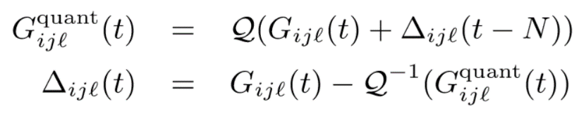
deep dive: 1-bit SGD
quantize gradients to but 1 bit per value with error feedback
carries over quantization error to next minibatch
1-Bit Stochastic Gradient Descent and its Application to Data-Parallel Distributed Training of Speech DNNs, InterSpeech 2014, F. Seide, H. Fu, J. Droppo, G. Li, D. Yu

Slide 48
deep dive: automatic minibatch scaling
goal: communicate less often
every now and then try to grow MB size on small subset
important: keep contribution per sample and momentum effect constant
hence define learning rate and momentum in a MB-size agnostic fashion
quickly scales up to MB sizes of 3k; runs at up to 100k samples

Slide 49
deep dive: Block Momentum
very recent, very effective parallelization method
goal: avoid to communicate after every minibatch
run a block of many minibatches without synchronization
then exchange and update with “block gradient”
problem: taking such a large step causes divergence
approach:
only add 1/K-th of the block gradient (K=#workers)
and carry over the missing (1-1/K) to the next block update (error residual like 1-bit SGD)
same as the common momentum formula
K. Chen, Q. Huo: “Scalable training of deep learning machines by incremental block training with intra-block parallel optimization and blockwise model-update filtering,” ICASSP 2016

Slide 50
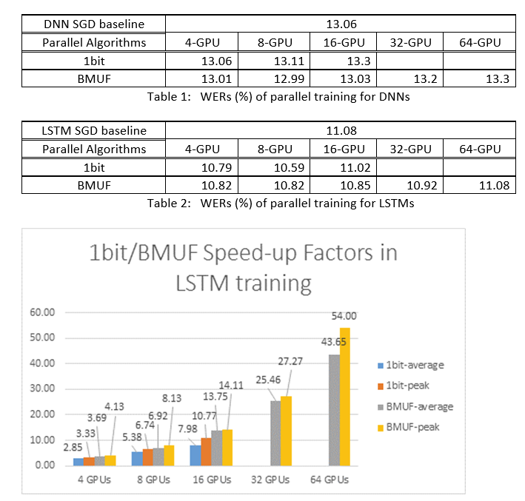
deep dive: data-parallel training
[Yongqiang Wang, IPG; internal communication]

Slide 51
I. what II. how III. deep dive IV. examples

Slide 52
examples: convolutional network https://github.com/Microsoft/CNTK/wiki/Hands-On-Labs-Image-Recognition
Task: Image classification with a convolutional network
model (features) = {
featNorm = features - 128
l1 = ConvolutionalLayer {32, (5x5), pad=true, activation=ReLU, initValueScale=0.1557/256} (featNorm)
p1 = MaxPoolingLayer {(3x3), stride=(2:2)} (l1)
l2 = ConvolutionalLayer {32, (5x5), pad=true, activation=ReLU, initValueScale=0.2} (p1)
p2 = MaxPoolingLayer {(3x3), stride=(2:2)} (l2)
l3 = ConvolutionalLayer {64, (5x5), pad=true, activation=ReLU, initValueScale=0.2} (p2)
p3 = MaxPoolingLayer {(3x3), stride=(2:2)} (l3)
d1 = DenseLayer {64, activation=ReLU, initValueScale=1.697} (p3)
z = LinearLayer {10, initValueScale=0.212} (d1)
}.z

Slide 53
examples: convolutional network https://github.com/Microsoft/CNTK/wiki/Hands-On-Labs-Image-Recognition
Task: Image classification with a convolutional network
model (features) = {
featNorm = features - 128
l1 = ConvolutionalLayer {32, (5:5), pad=true, activation=ReLU, initValueScale=0.1557/256} (featNorm)
p1 = MaxPoolingLayer {(3:3), stride=(2:2)} (l1)
l2 = ConvolutionalLayer {32, (5:5), pad=true, activation=ReLU, initValueScale=0.2} (p1)
p2 = MaxPoolingLayer {(3:3), stride=(2:2)} (l2)
l3 = ConvolutionalLayer {64, (5:5), pad=true, activation=ReLU, initValueScale=0.2} (p2)
p3 = MaxPoolingLayer {(3:3), stride=(2:2)} (l3)
d1 = DenseLayer {64, activation=ReLU, initValueScale=1.697} (p3)
z = LinearLayer {10, initValueScale=0.212} (d1)
}.z

Slide 54
examples: language understanding https://github.com/Microsoft/CNTK/wiki/Hands-On-Labs-Language-Understanding
Task: Slot tagging with an LSTM
19 |x 178:1 |# BOS |y 128:1 |# O
19 |x 770:1 |# show |y 128:1 |# O
19 |x 429:1 |# flights |y 128:1 |# O
19 |x 444:1 |# from |y 128:1 |# O
19 |x 272:1 |# burbank |y 48:1 |# B-fromloc.city_name
19 |x 851:1 |# to |y 128:1 |# O
19 |x 789:1 |# st. |y 78:1 |# B-toloc.city_name
19 |x 564:1 |# louis |y 125:1 |# I-toloc.city_name
19 |x 654:1 |# on |y 128:1 |# O
19 |x 601:1 |# monday |y 26:1 |# B-depart_date.day_name
19 |x 179:1 |# EOS |y 128:1 |# O

Slide 55
examples: language understanding https://github.com/Microsoft/CNTK/wiki/Hands-On-Labs-Language-Understanding
Task: Slot tagging with an LSTM
19 |x 178:1 |# BOS |y 128:1 |# O
19 |x 770:1 |# show |y 128:1 |# O
19 |x 429:1 |# flights |y 128:1 |# O
19 |x 444:1 |# from |y 128:1 |# O
19 |x 272:1 |# burbank |y 48:1 |# B-fromloc.city_name
19 |x 851:1 |# to |y 128:1 |# O
19 |x 789:1 |# st. |y 78:1 |# B-toloc.city_name
19 |x 564:1 |# louis |y 125:1 |# I-toloc.city_name
19 |x 654:1 |# on |y 128:1 |# O
19 |x 601:1 |# monday |y 26:1 |# B-depart_date.day_name
19 |x 179:1 |# EOS |y 128:1 |# O
y "O" "O" "O" "O" "B-fromloc.city_name"
^ ^ ^ ^ ^
| | | | |
+-------+ +-------+ +-------+ +-------+ +-------+
| Dense | | Dense | | Dense | | Dense | | Dense | ...
+-------+ +-------+ +-------+ +-------+ +-------+
^ ^ ^ ^ ^
| | | | |
+------+ +------+ +------+ +------+ +------+
0 -->| LSTM |-->| LSTM |-->| LSTM |-->| LSTM |-->| LSTM |-->...
+------+ +------+ +------+ +------+ +------+
^ ^ ^ ^ ^
| | | | |
+-------+ +-------+ +-------+ +-------+ +-------+
| Embed | | Embed | | Embed | | Embed | | Embed | ...
+-------+ +-------+ +-------+ +-------+ +-------+
^ ^ ^ ^ ^
| | | | |
x ------>+--------->+--------->+--------->+--------->+------...
BOS "show" "flights" "from" "burbank"

Slide 56
examples: language understanding https://github.com/Microsoft/CNTK/wiki/Hands-On-Labs-Language-Understanding
Task: Slot tagging with an LSTM
19 |x 178:1 |# BOS |y 128:1 |# O
19 |x 770:1 |# show |y 128:1 |# O
19 |x 429:1 |# flights |y 128:1 |# O
19 |x 444:1 |# from |y 128:1 |# O
19 |x 272:1 |# burbank |y 48:1 |# B-fromloc.city_name
19 |x 851:1 |# to |y 128:1 |# O
19 |x 789:1 |# st. |y 78:1 |# B-toloc.city_name
19 |x 564:1 |# louis |y 125:1 |# I-toloc.city_name
19 |x 654:1 |# on |y 128:1 |# O
19 |x 601:1 |# monday |y 26:1 |# B-depart_date.day_name
19 |x 179:1 |# EOS |y 128:1 |# O
y "O" "O" "O" "O" "B-fromloc.city_name"
^ ^ ^ ^ ^
| | | | |
+-------+ +-------+ +-------+ +-------+ +-------+
| Dense | | Dense | | Dense | | Dense | | Dense | ...
+-------+ +-------+ +-------+ +-------+ +-------+
^ ^ ^ ^ ^
| | | | |
+------+ +------+ +------+ +------+ +------+
0 -->| LSTM |-->| LSTM |-->| LSTM |-->| LSTM |-->| LSTM |-->...
+------+ +------+ +------+ +------+ +------+
^ ^ ^ ^ ^
| | | | |
+-------+ +-------+ +-------+ +-------+ +-------+
| Embed | | Embed | | Embed | | Embed | | Embed | ...
+-------+ +-------+ +-------+ +-------+ +-------+
^ ^ ^ ^ ^
| | | | |
x ------>+--------->+--------->+--------->+--------->+------...
BOS "show" "flights" "from" "burbank"

Slide 57
examples: language understanding https://github.com/Microsoft/CNTK/wiki/Hands-On-Labs-Language-Understanding
Task: Slot tagging with an LSTM
model = Sequential (
EmbeddingLayer {150} :
RecurrentLSTMLayer {300} :
DenseLayer {labelDim}
)
y "O" "O" "O" "O" "B-fromloc.city_name"
^ ^ ^ ^ ^
| | | | |
+-------+ +-------+ +-------+ +-------+ +-------+
| Dense | | Dense | | Dense | | Dense | | Dense | ...
+-------+ +-------+ +-------+ +-------+ +-------+
^ ^ ^ ^ ^
| | | | |
+------+ +------+ +------+ +------+ +------+
0 -->| LSTM |-->| LSTM |-->| LSTM |-->| LSTM |-->| LSTM |-->...
+------+ +------+ +------+ +------+ +------+
^ ^ ^ ^ ^
| | | | |
+-------+ +-------+ +-------+ +-------+ +-------+
| Embed | | Embed | | Embed | | Embed | | Embed | ...
+-------+ +-------+ +-------+ +-------+ +-------+
^ ^ ^ ^ ^
| | | | |
x ------>+--------->+--------->+--------->+--------->+------...
BOS "show" "flights" "from" "burbank"

Slide 58
examples: language understanding in Python¹
Task: Slot tagging with an LSTM
def LSTM_sequence_classifer_net(x, num_output_classes, embedding_dim, LSTM_dim, cell_dim):
e = embedding(x, embedding_dim)
r = LSTMP_component_with_self_stabilization(e, LSTM_dim, cell_dim)[0]
z = linear_layer(r, num_output_classes)
return z
¹ beta scheduled for October 2016
y "O" "O" "O" "O" "B-fromloc.city_name"
^ ^ ^ ^ ^
| | | | |
+-------+ +-------+ +-------+ +-------+ +-------+
| Dense | | Dense | | Dense | | Dense | | Dense | ...
+-------+ +-------+ +-------+ +-------+ +-------+
^ ^ ^ ^ ^
| | | | |
+------+ +------+ +------+ +------+ +------+
0 -->| LSTM |-->| LSTM |-->| LSTM |-->| LSTM |-->| LSTM |-->...
+------+ +------+ +------+ +------+ +------+
^ ^ ^ ^ ^
| | | | |
+-------+ +-------+ +-------+ +-------+ +-------+
| Embed | | Embed | | Embed | | Embed | | Embed | ...
+-------+ +-------+ +-------+ +-------+ +-------+
^ ^ ^ ^ ^
| | | | |
x ------>+--------->+--------->+--------->+--------->+------...
BOS "show" "flights" "from" "burbank"

Slide 59
examples: language understanding in Python
# features and label inputs
x = input_variable(shape=input_dim, is_sparse=True)
y = input_variable(num_output_classes, is_sparse=True)
# network
z = LSTM_sequence_classifer_net(x, num_output_classes, embedding_dim, hidden_dim, cell_dim)
# loss and metric
ce = cross_entropy_with_softmax(z, y)
errs = classification_error(z, y)
# minibatch source
mb_source = text_format_minibatch_source(path, [
StreamConfiguration('x', input_dim, True, 'x'),
StreamConfiguration('y', num_output_classes, True, 'y')], 0)
features_si = mb_source.stream_info(features)
labels_si = mb_source.stream_info(label)
# Instantiate the trainer object to drive the model training
lr = lr = learning_rates_per_sample(0.0005)
trainer = Trainer(classifier_output, ce, pe, [sgd_learner(classifier_output.owner.parameters(), lr)])
# Get minibatches of sequences to train with and perform model training
minibatch_size = 200
training_progress_output_freq = 10
i = 0;
while True:
mb = mb_source.get_next_minibatch(minibatch_size)
if len(mb) == 0:
break
# Specify the mapping of input variables in the model to actual minibatch data to be trained with
arguments = {features : mb[features_si].m_data, label : mb[labels_si].m_data}
trainer.train_minibatch(arguments)
print_training_progress(trainer, i, training_progress_output_freq)
i += 1
if __name__=='__main__':
# Specify the target device to be used for computing
target_device = DeviceDescriptor.cpu_device()
DeviceDescriptor.set_default_device(target_device)
train_sequence_classifier()

Slide 60
examples: language understanding in Python
# Instantiate the trainer object to drive the model training
trainer = Trainer(z, ce, errs, [sgd_learner(z.owner.parameters(), 0.0005)])
# Get minibatches of sequences to train with and perform model training
i = 0;
while True:
mb = mb_source.get_next_minibatch(minibatch_size)
if len(mb) == 0:
break
x_si = mb_source.stream_info(features); y_si = mb_source.stream_info(label)
arguments = {x : mb[x_si].m_data, y : mb[y_si].m_data}
# process one minibatch (forward, backwards, model update)
trainer.train_minibatch(arguments)
print_training_progress(trainer, i, training_progress_output_freq)
i += 1

Slide 61
I. what II. how III. deep dive IV. examples

Slide 62
on our roadmap
C++ and Python API enables
IDE support
data I/O code reuse
reinforcement learning, adversarial learning, other non-standard SGD
integration with
C#/.Net, R
Keras
HDFS and Spark
technology
memory: swapping, model parallelism
models: nested loops, CTC
training: ASGD, NCCL (from NVidia)
evaluation: 16-bit support, ARM, FPGA

Slide 63
CNTK: democratizing the AI tool chain
ease of use
what, not how (sequence batching/unrolling, gradients, memory reuse, MPI)
powerful stock library: feed-forward DNN, recurrent, convolution, DSSM; speech, vision, text
fast
optimized for GPU and NVidia GPU libraries
best-in-class multi-GPU/multi-server algorithms
flexible
down-to-earth, elegant, powerful, composable network description
Python support: beta in October
1st-class Windows support
and Linux, too
internal=external version

Slide 64
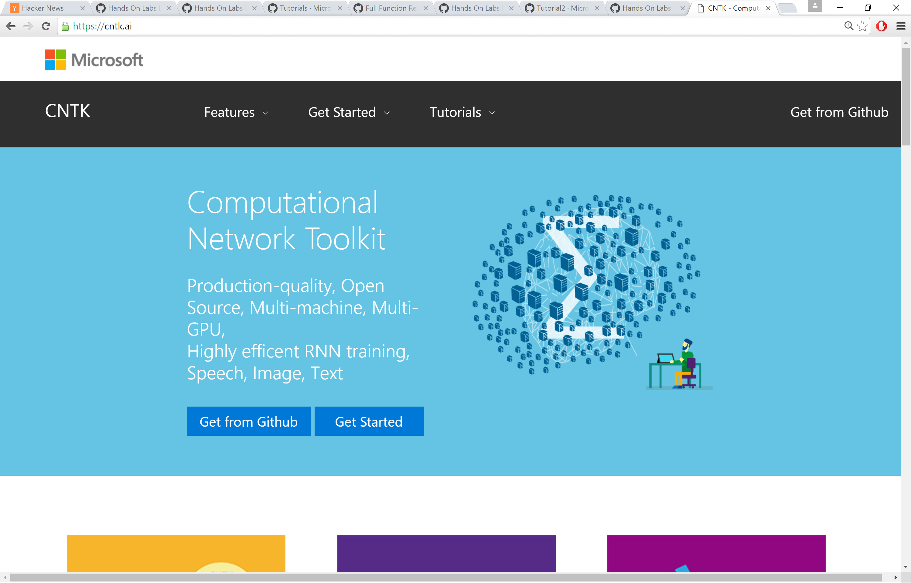
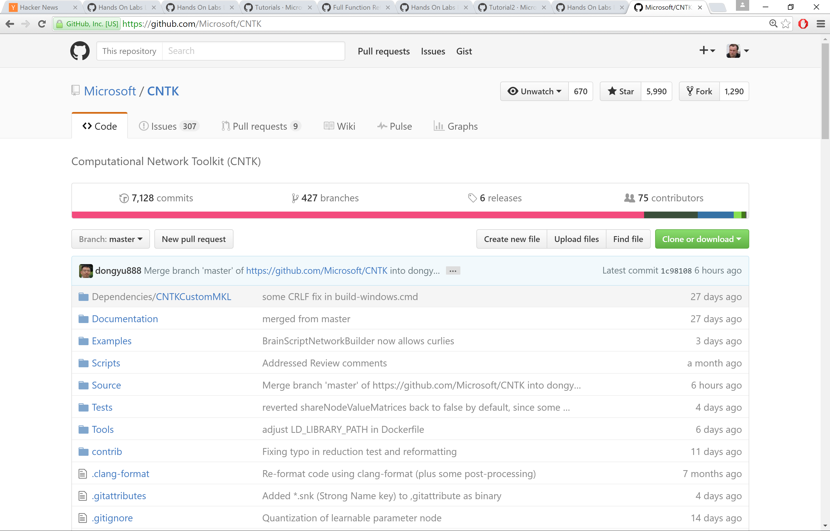
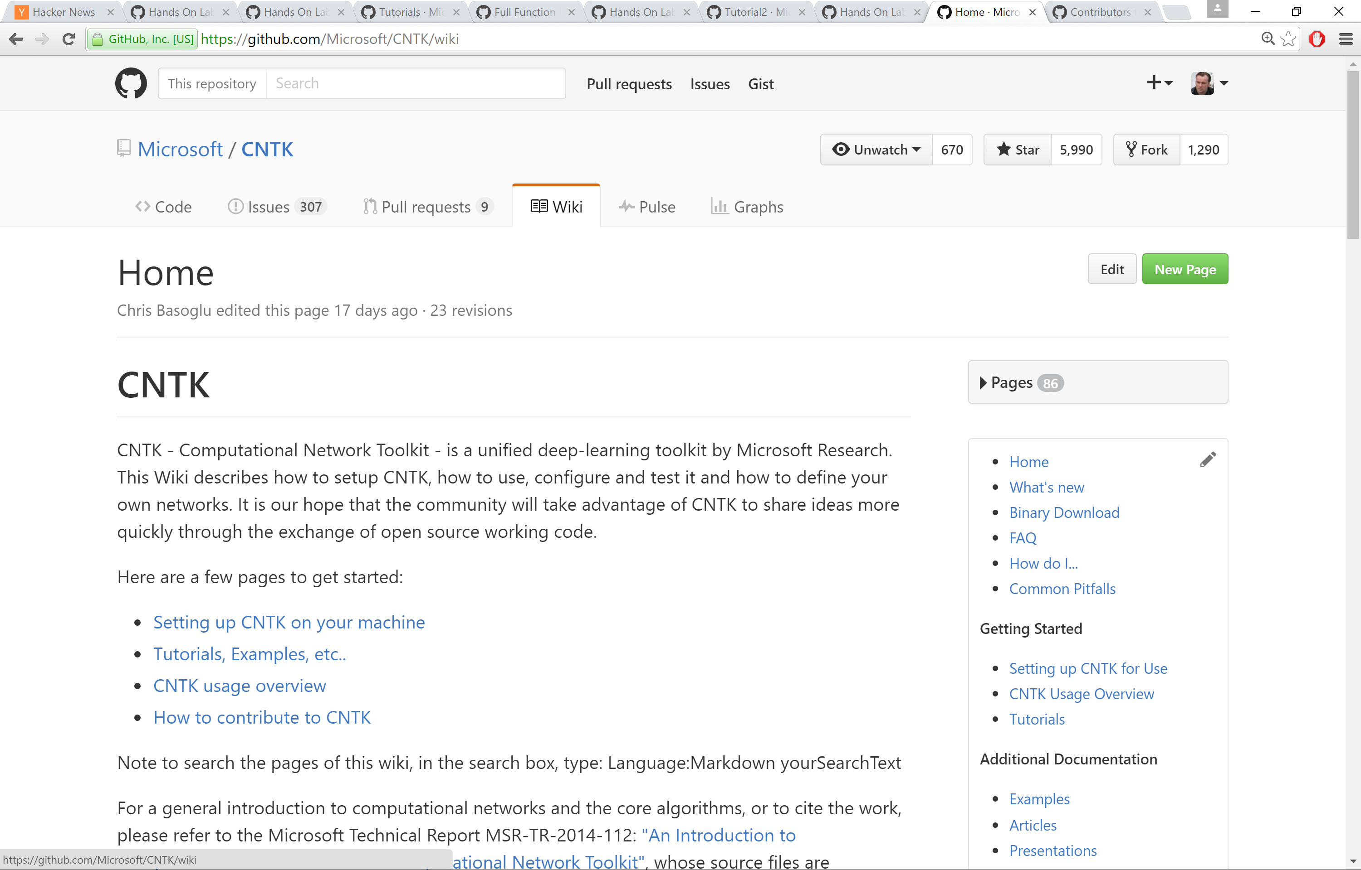
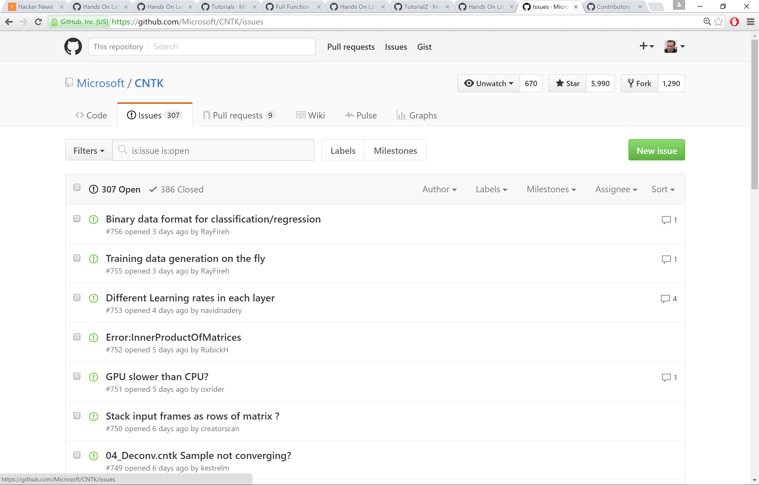
CNTK: democratizing the AI tool chain
Web site: https://cntk.ai/
Github: https://github.com/Microsoft/CNTK
Wiki: https://github.com/Microsoft/CNTK/wiki
Issues: https://github.com/Microsoft/CNTK/issues
mailto:fseide@microsoft.com; meet the speakers: GWCC A408

